Slide 1


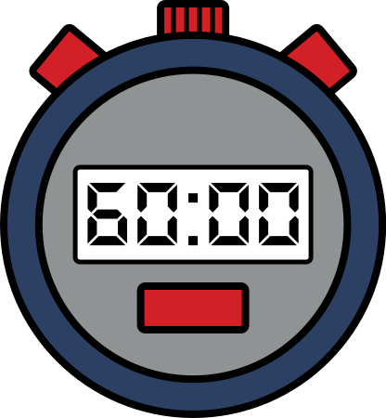
Task: 8
Search
Even digits problem

Slide 2

Welcome to the team:
Dinesh Reddy
Asritha valli
Jaya krishna
akanksh guptha
Harsha vardhan
Are you ready ?

Slide 3

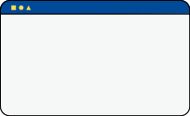

Introduction
THE CALCULATOR HAS + BUTTON AND - BUTTON AND N IS DISPLAYING ON SCREEN
WHEN WE PRESS + BUTTON IT WILL BECOME N+1 AND WHEN –BUTTON IS CLICKED IT WILL BECOME N-1
THIS N CONTAINS BOTH ODD AND EVEN DIGITS BUT SUPENIN WANTS ONLY EVEN DIGITS IN IT
EXAMPLE:24482=ALL NUMBERS ARE EVEN
If we have 5 but we have to do it 8. To do it we have to press + button for 3 times.
Our answer lies in n1 and n4.
Ans : min(n1-n, n-n4)

Slide 4




1 < T< 100 >>>>>>→max test cases=100
1 < N < 10^16 >>>>>>→value of N is 10^16.
We have N when we press + button it increases . So we have to check weather number is even or not.
Egxample :22446%10 >>>>> →last digit is even f=0
22446%10=2244 =last digit is even
2244%10=224 =last digit is even
224%10=22 =last digit is even
22%10=2 =last digit is even
Concept
we have to check whether number is even or not.
22446 10 = 2244 22uu plus/minus 10 = 224 - ++ digit is even.
Eg:- 22446 laut alight → last oven - f = 0 224 10 = 22 22 = 10 Back Retake Share everything became per so number & even.
DeleteEdit
1 ≤ T ≤ 100 → Max test cases = 100 1 N≤ 10 16 →value of Nis 16We have N when we press button it increases.

Slide 5
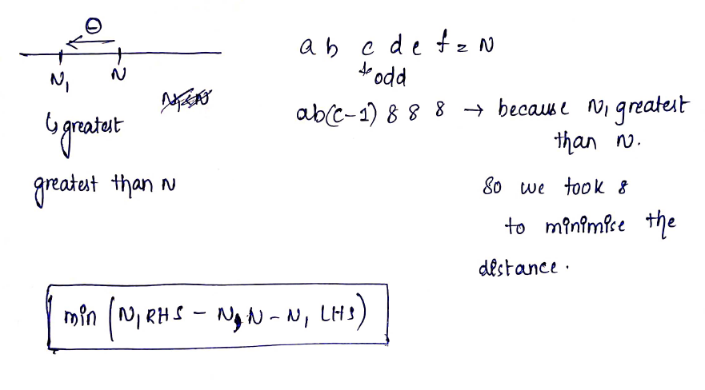

eg : Let's say we have 225693 5 is odd so we will have increment it as 226000
[ans = ans + 2]X10 e.g Let's think we have number 229 9 is odd we stored this even number 22 as ans
So ans = (22 + 2)X10 = 240
So nearest even digit for 229 is 240.
When we are travelling from right to left let's think one of our variable is 0 ans = 0 then (ans = ans X 10)+(varbl)
When we got first odd digit (ans = ans X 10) + () + 1 != 9....
So at last digit is odd we will break the loop.
Let’s thing our number is a b c d e f =N
We start moving from ab now let’s thing c is odd.
So we have to increament c to do ti even so c+1.
As we did c+1 now it become gra=eater than N so we will do remaining digits as 0.
In N1 and N2 and N3 , N1 is smaller than N.
a b c+1 0 0 0

Slide 6

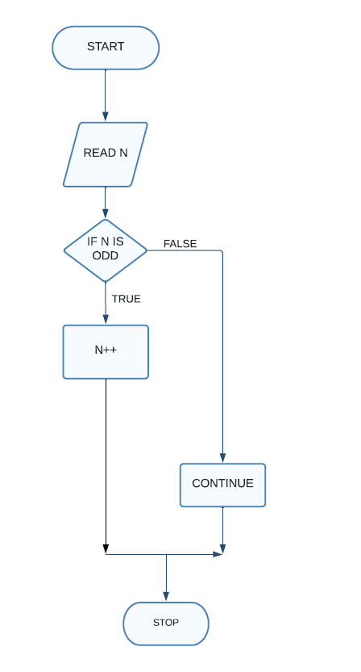
Flowchart:
Search
Save
Cancel

Slide 7


Algorithm:
1
2
3
4
5
Start
find 2 numbers, whose all digits are even, closest to N on both sides, namely b and s, b is bigger than N, s is smaller than N.
.find highest odd digit in N, if N = 4389901, then highest odd digit is 3.
highest odd digit minus 1, and set all digits below to 8, then we get s. If N = 4389901, then s = 4288888.
highest odd digit plus 1, and set all digits below to 0, in most cases, we get b. If N = 4389901, then b = 4400000

Slide 8

Algorithm:
6
7
Print min(b - N, N - s)
Stop

Slide 9



Program:
N = int(input())
for x in range(N):
A = str(input())
numberOfDigits = len(A)
firstOddDigitIndex = -1
for y in range(numberOfDigits):
if int(A[y]) % 2 != 0:
firstOddDigitIndex = y
break
if firstOddDigitIndex == -1:
print("Case #{}: {}".format(int(x+1), 0))
elif firstOddDigitIndex == numberOfDigits-1:
print("Case #{}: {}".format(int(x+1), 1))
else:
# mainNum is the slice of the original number from the first odd digit to the end
mainNum = int(A[firstOddDigitIndex: ])
numberOfDigitsInMain = len(str(mainNum))
# numberWithZeroes is the number used to replace all the digits to the right of the first odd digit with zeroes
numberWithZeroes = 10 ** (numberOfDigitsInMain - 1)
# numberWithEights is the number used to replace all the digits to the right of the first odd digit with eights
numberWithEights = ''.join(['8' for x in range(numberOfDigitsInMain - 1)])
firstOddDigit = int(str(mainNum)[ :1])
UpNum = (firstOddDigit + 1) * numberWithZeroes
DownNum = int(str(firstOddDigit - 1) + numberWithEights)
numberOfKeys = mainNum - DownNum if A[firstOddDigitIndex] == '9' else min(UpNum - mainNum, mainNum - DownNum)
print("Case #{}: {}".format(int(x+1), numberOfKeys))

Slide 10

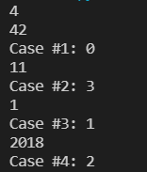

Output
screenshot:

Slide 11

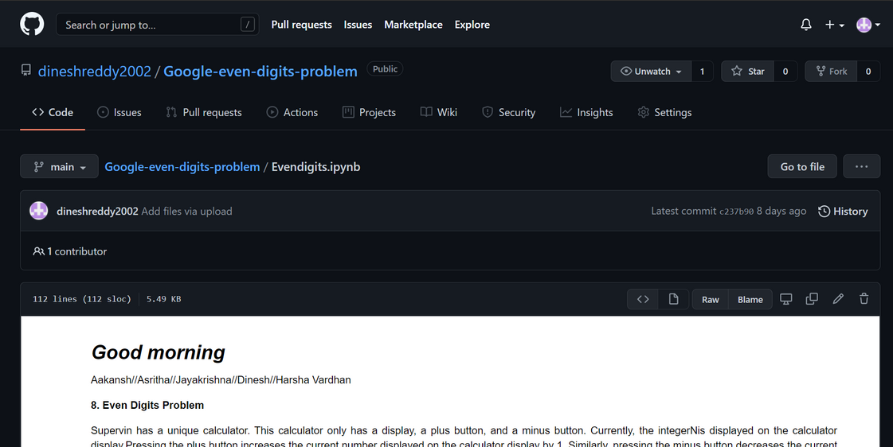
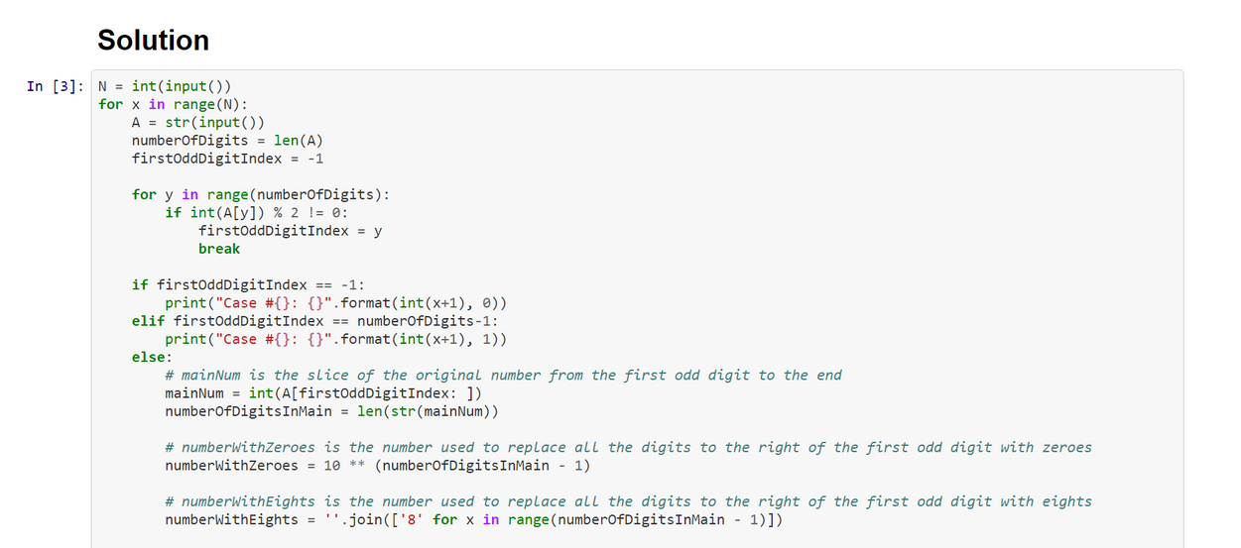
Round 1
GitHub Screenshot

Slide 12


Contribution
M1
M2
M3
M4
Jaya krishna
Harsh vardhan
Asritha
Dinesh Reddy
M5
Akansh

Slide 13



Thank you!
Until our next pretty debate!

